Slide 1
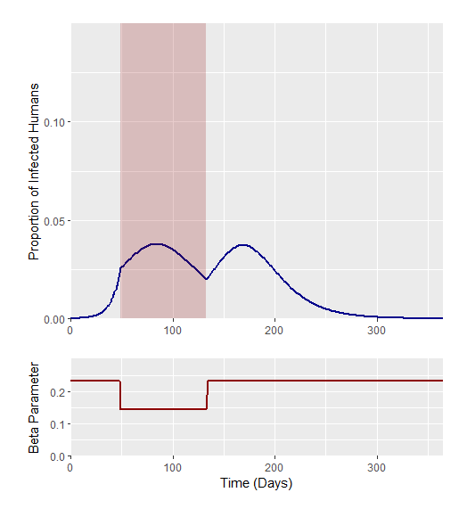
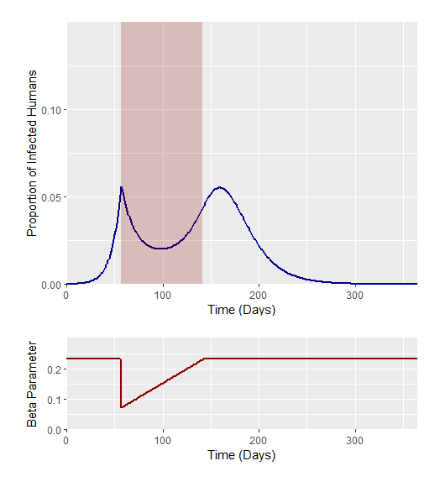
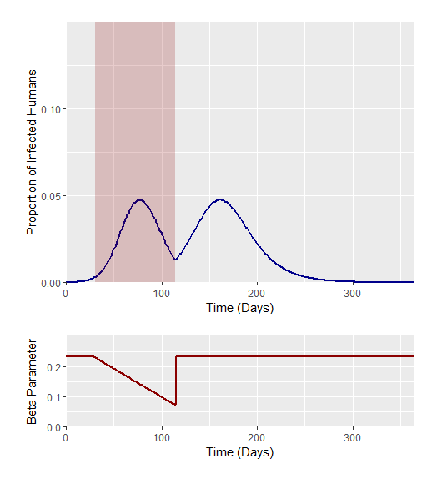
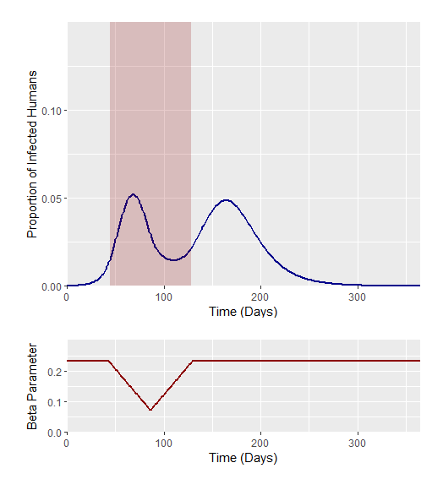




Optimal Trigger Time Analysis – Interventions run for 12 weeks – Optimal defined as lowest peak
Scenario 1
Scenario 2
Scenario 3
Scenario 4
Base Beta = 0.2310491
Beta Min = 0.1444057
Base Beta = 0.2310491
Beta Min = 0.07220283
Base Beta = 0.2310491
Beta Min = 0.07220283
Base Beta = 0.2310491
Beta Min = 0.07220283

Slide 2
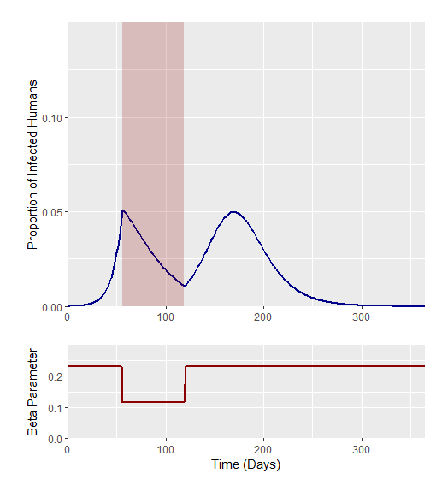

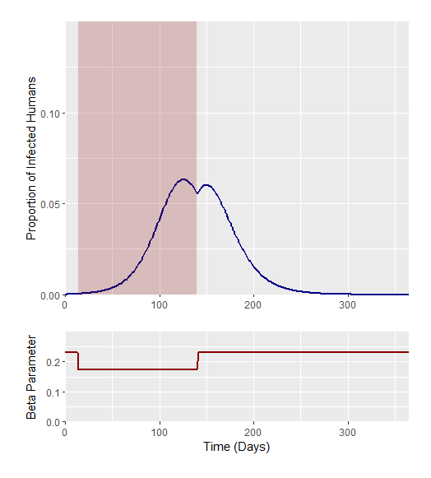
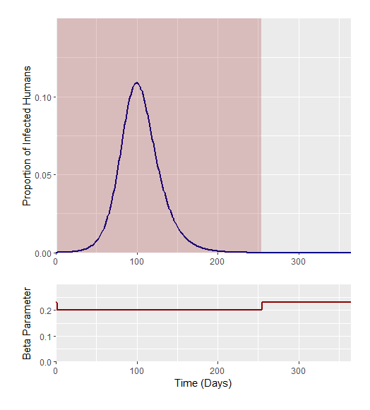




SCENARIO 1 – Immediate Reduction in Beta for X weeks
Beta Decrease * Length = Total Magnitude of Beta Decrease
Length = Total Magnitude of Beta Decrease/ Beta Decrease
Scenario 1.1
Scenario 1.2
Scenario 1.3
Scenario 1.4
? * 9 = 4.5
4.5/9 = 0.5
0.675 * 12 = 4.5
4.5/12 = 0.375
? * 18 = 4.5
4.5/18 = 0.25
? * 36 = 4.5
4.5/36 = 0.125

